Slide 1





Class 6917:
Guided research methodologies
Comparative Analysis of Image Classification Models for Efficient and Accurate Classification across Noisy Vegetable Images
by Yusif Mukhtarov
08.03.2023

Slide 2

Project objective
01
Primary objective: Noisy image classification without denoising techniques
02
2.1 Direct classification of images takes less time and computational power.
2.2 In real world scenarios some images cannot be perfectly denoised.
2.3 Preservation of information.
2.4 Transferability to other domains.
03
Finding out the best model for the noisy image classification

Slide 3
Problems
Solutions
Lack of real-world Data
Computational power
Threshold
Artificially generated noise
Pretrained models
Limited number of parameters

Slide 4
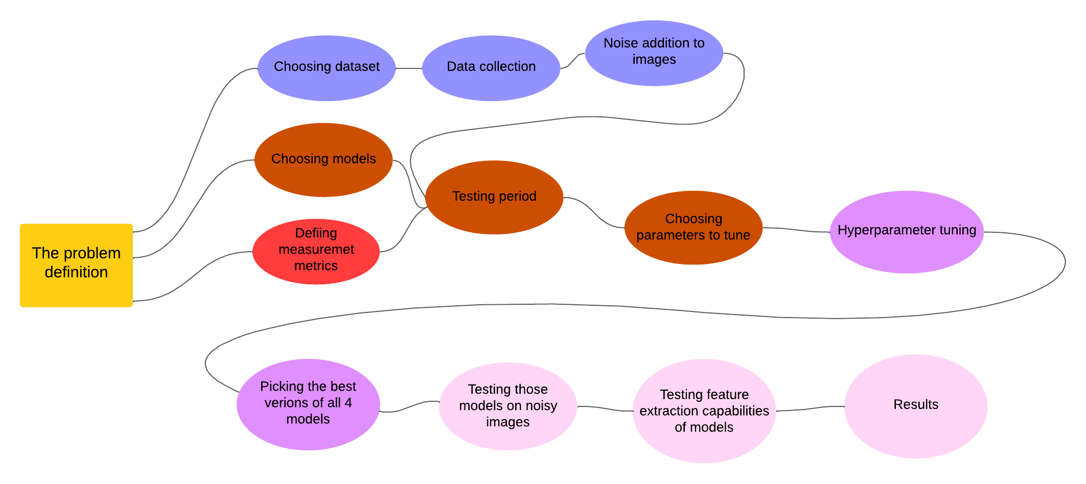
Architecture diagram

Slide 5
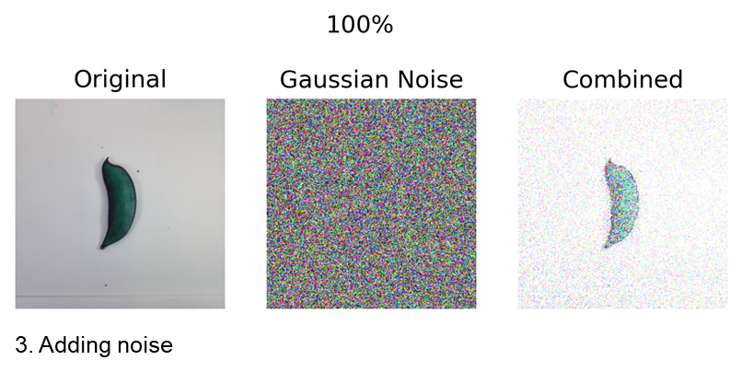
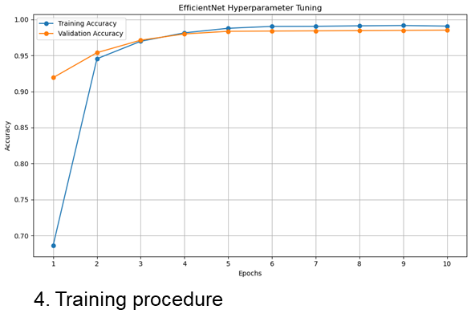
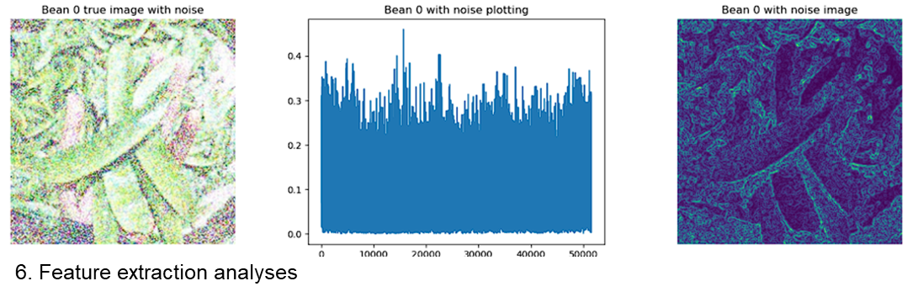
Steps
1
Models. AlexNet, VGG16, EfficientNet, and ResNet.
2
Dataset. Vegetable image dataset.
3
Noise. Gaussian Noise.
4
Hyperparameters tuning. Learning rate scheduler gamma and step size, momentum.
5
Testing. Accuracy, precision, recall and time.
6
Result and feature extraction analysis.

Slide 6
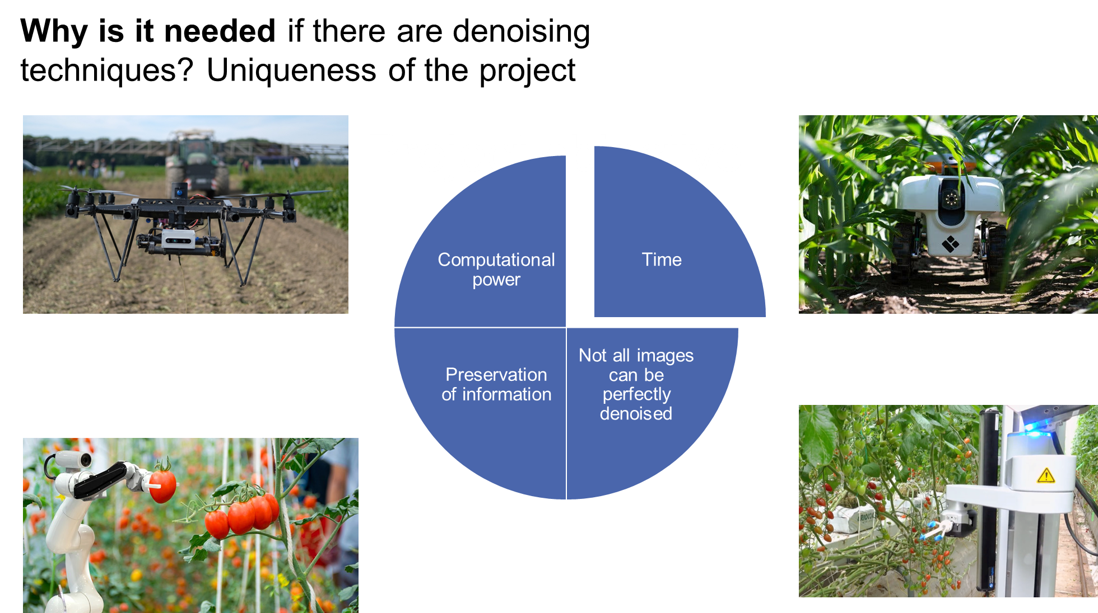

Slide 7
Hyperparameter tuning
model | n | lr | m | s | g | a
alexnet | 10 | 0.005 | 0 | 3 | 0.5 | 0.990
alexnet | 10 | 0.005 | 0.1 | 3 | 0.1 | 0.989
alexnet | 10 | 0.005 | 0 | 3 | 0.1 | 0.988
model | n | lr | m | s | g | a
vgg16 | 10 | 0.005 | 0.1 | 3 | 0.1 | 0.986
vgg16 | 10 | 0.005 | 0 | 3 | 0.5 | 0.984
vgg16 | 10 | 0.005 | 0 | 3 | 0.1 | 0.982
model | n | lr | m | s | g | a
effNet | 10 | 0.005 | 0.1 | 3 | 0.1 | 0.988
effNet | 10 | 0.005 | 0 | 3 | 0.1 | 0.987
effNet | 10 | 0.005 | 0.1 | 4 | 0.1 | 0.987
model | n | lr | m | s | g | a
resnet | 10 | 0.005 | 0.1 | 4 | 0.1 | 0.995
resnet | 10 | 0.005 | 0.1 | 3 | 0.1 | 0.994
resnet | 10 | 0.005 | 0.1 | 4 | 0.5 | 0.994

Slide 8
Testing results
model | noise_percentage | accuracy | precision | f | time
alexnet | 10 | 98.97 | 0.99 | 0.99 | 0.065
resnet | 10 | 98.3 | 0.98 | 0.98 | 0.721
efficientnet | 10 | 98.13 | 0.98 | 0.98 | 0.583
vgg16 | 10 | 97.7 | 0.98 | 0.97 | 12.194
model | noise_percentage | accuracy | precision | f | time
resnet | 20 | 93.37 | 0.94 | 0.93 | 0.667
efficientnet | 20 | 91 | 0.93 | 0.91 | 0.497
alexnet | 20 | 89.87 | 0.92 | 0.89 | 0.067
vgg16 | 20 | 73.27 | 0.82 | 0.71 | 12.227

Slide 9
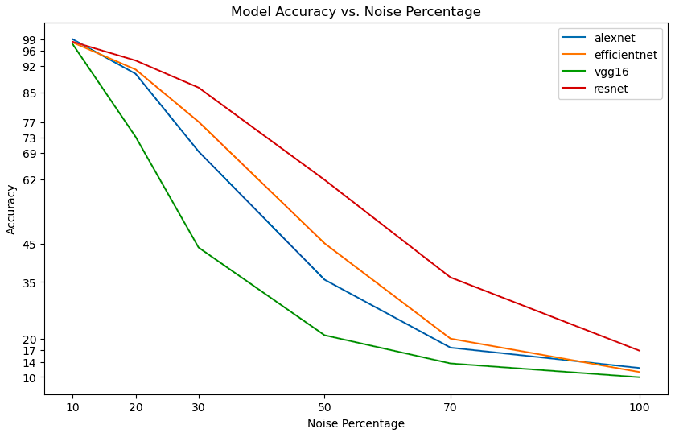

Slide 10
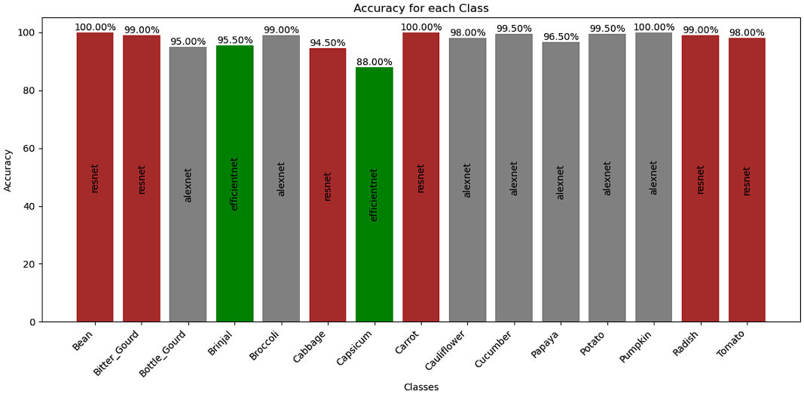

Slide 11
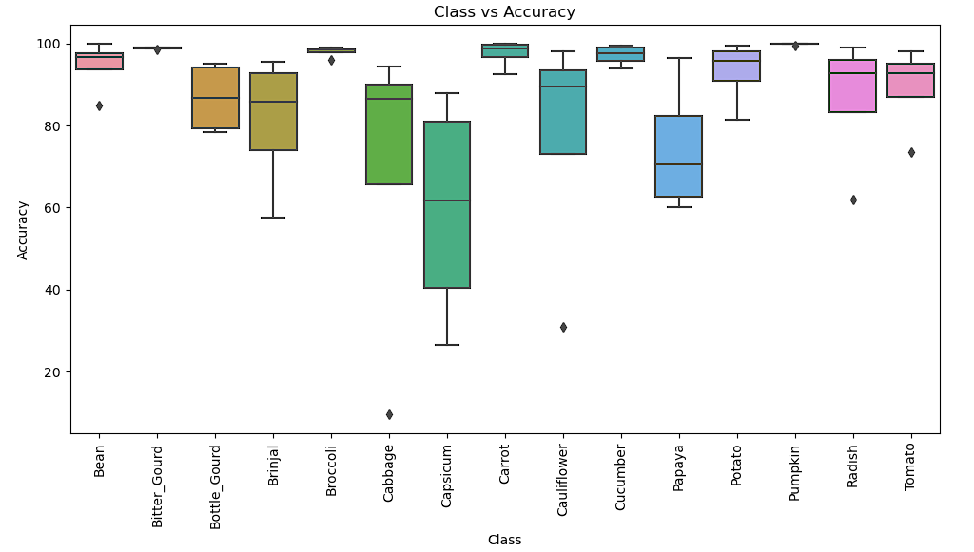

Slide 12
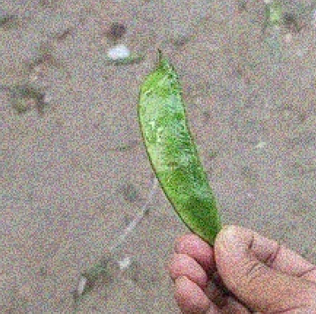
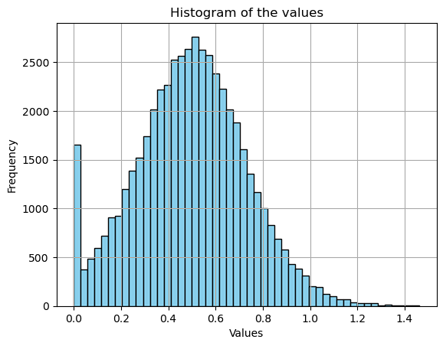
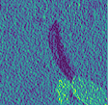
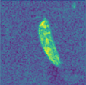
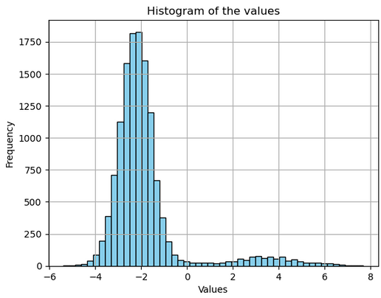
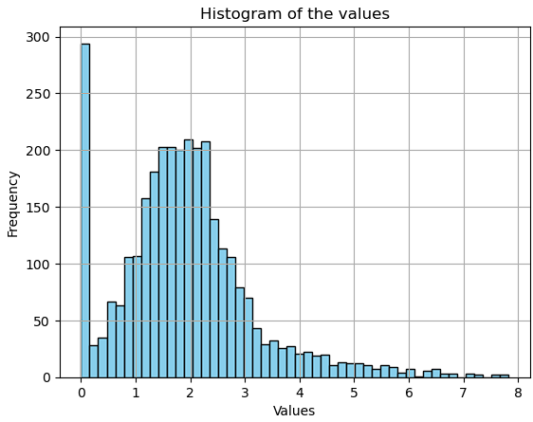
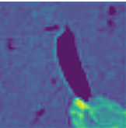
Original
Vgg16
EfficientNet
AlexNet

Slide 13
Results
Future work
Accuracies of 4 models for 15 classes on 7 datasets
Hyperparameter tuning results for 4 models testing 8 parameters
Feature extraction analyses of 4 models on 7 datasets
Customized neural network
Naturally produced noisy images
Defining threshold
Transfering to other domains

